Slide 1

Intro into AI Lab
Reinforcement Learning

Slide 2
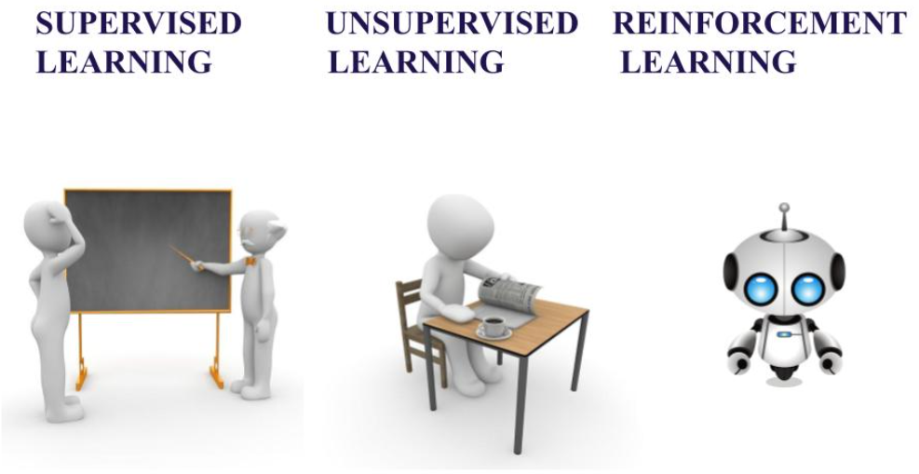
Machine Learning Paradigms – An Overview

Slide 3
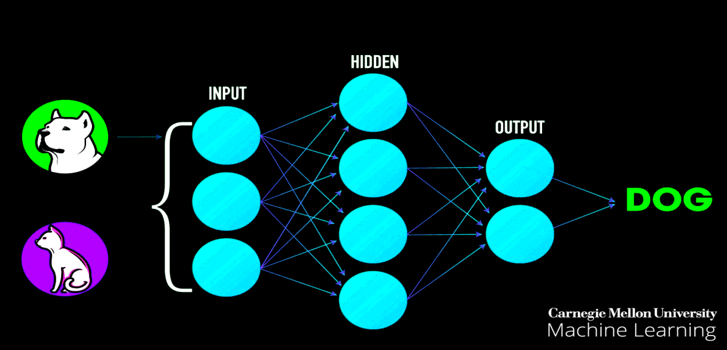
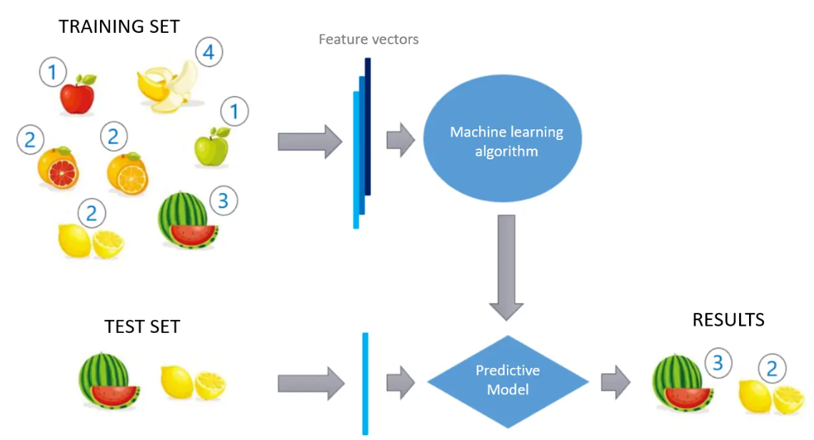
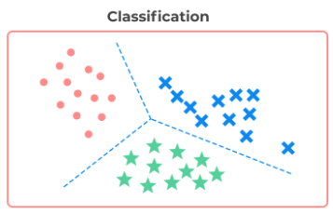
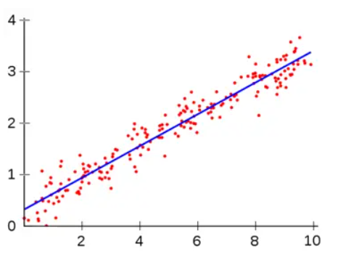
Supervised Learning
Training set to teach models to yield the desired output.
Training dataset includes inputs and correct outputs (targets), which allow the model to learn over time.
The algorithm measures its accuracy through the loss function, adjusting until the error is minimized.
Deals with classification and regression. Eg: Classifying cats and dogs, by training on images of the two categories or Forecasting temperature using data over the past years.
Regression

Slide 4
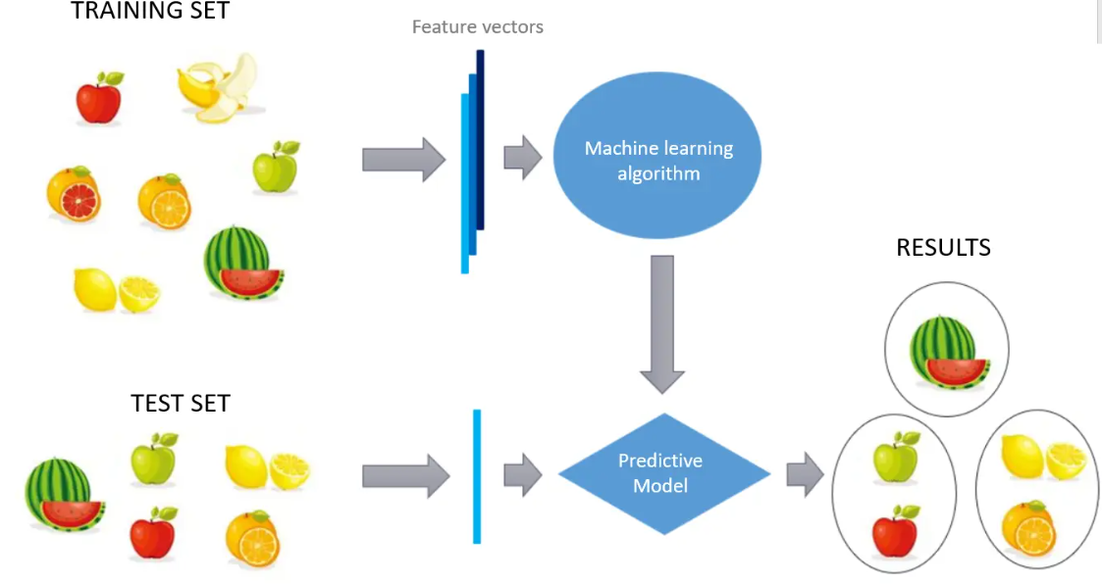
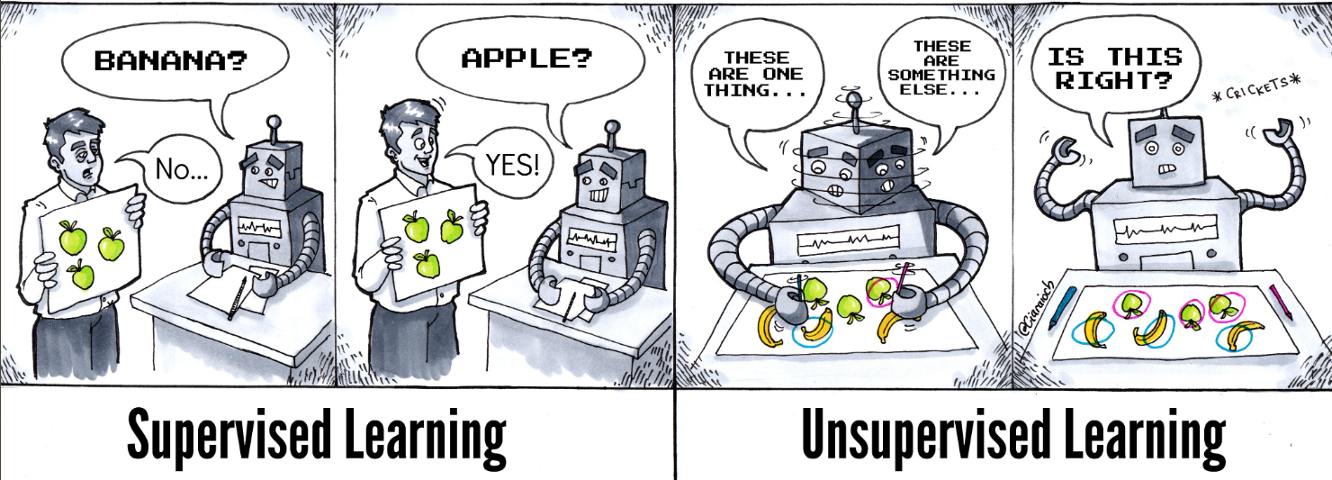
Unsupervised Learning
Training using data that is neither classified nor labeled.
No teacher or guidance is provided.
Task of the algorithm is to group according to similarities, patterns, and differences without any prior training.
Model to work on its own to discover patterns and information that was previously undetected. Eg: Clustering algorithms. (K-Means clustering)

Slide 5
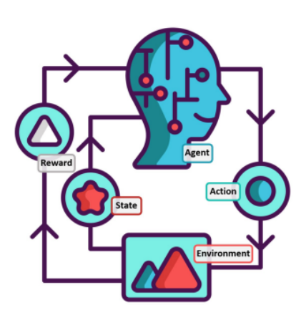

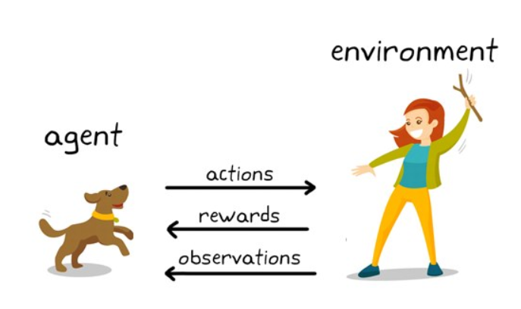
Reinforcement Learning (RL)
RL is a framework for learning how to interact with the environment from experience.
A machine learning method based on rewarding desired behaviors and/or punishing undesired ones. In general, a reinforcement learning agent is able to perceive and interpret its environment, take actions and learn through trial and error.

Slide 6
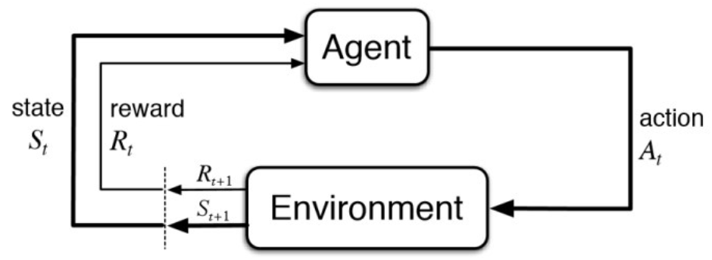
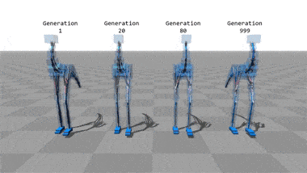
Reinforcement Learning (RL)
An agent tries to manipulate the environment by acting on it. Thus the agent changes the state to another. The agent in turn gets a reward (appreciation) on success but will not receive any reward or sometimes negative rewards on failure. In this way, the agent learns from the environment
Reinforcement learning is being used to learn to walk in the case of a bipedal walker in a simulated environment. The system learns better with iteration.

Slide 7
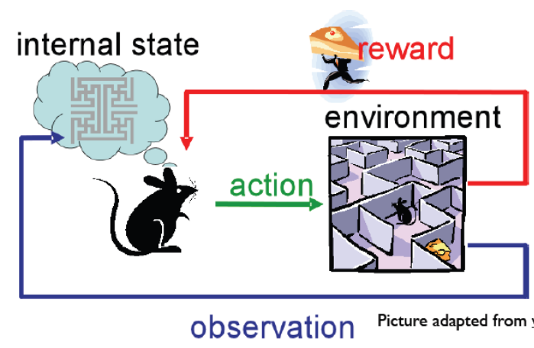
Reinforcement Learning (RL) - Teminologies
Agent : Subject that interacts with the environment.
Environment: Physical world in which the agent operates
State: Current situation of the agent in the Environment
Reward: Feedback from the environment after executing an Action
Policy: Mapping from the perceived states of the environment to actions to be taken when in those states
Overview of RL
Learning from interaction with an environment to achieve some long-term goal that is related to the state of the environment.
The goal is defined by reward signal, which must be maximized.
Agent must be able to partially/fully sense the environment state and take actions to influence the environment state.

Slide 8
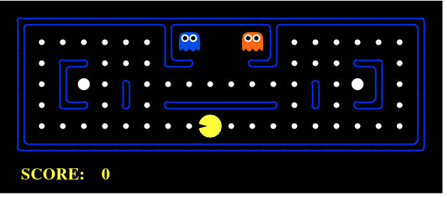
RL explained via games.
A Reinforcement Learning problem can be best explained through games.
Let’s take the game of PacMan where the goal of the agent (PacMan) is to eat the food in the grid while avoiding the ghosts on its way. The grid world is the interactive environment for the agent. PacMan receives a reward for eating food and punishment if it gets killed by the ghost (loses the game). The states are the location of PacMan in the grid world and the total cumulative reward is PacMan winning the game

Slide 9
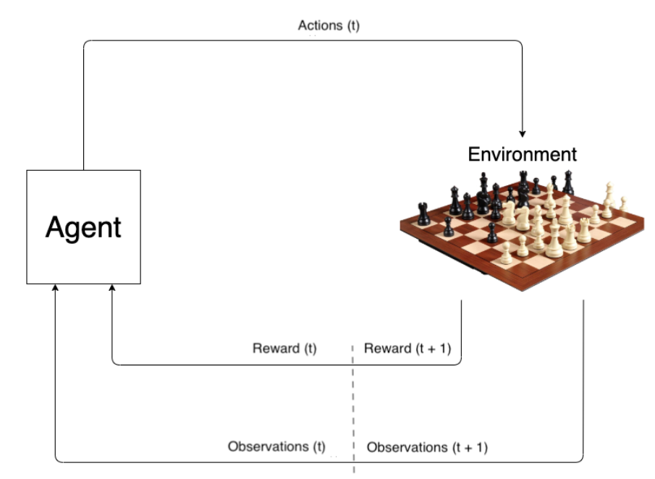
RL explained via games.
Chess game:
It is an interesting environment, as it involves not just the rules of the game. But also an adversary trying to beat the opponent (checkmate each other). In short an active player at the other end. Chess involves a huge number of discrete states of the order of 10 ^ 80 or so. Actions taken at each time step changes the state (board configuration). These actions may give rewards at some time steps, but often there is only reward at the end of the game. This is called sparse reward setting (explained later).

Slide 10
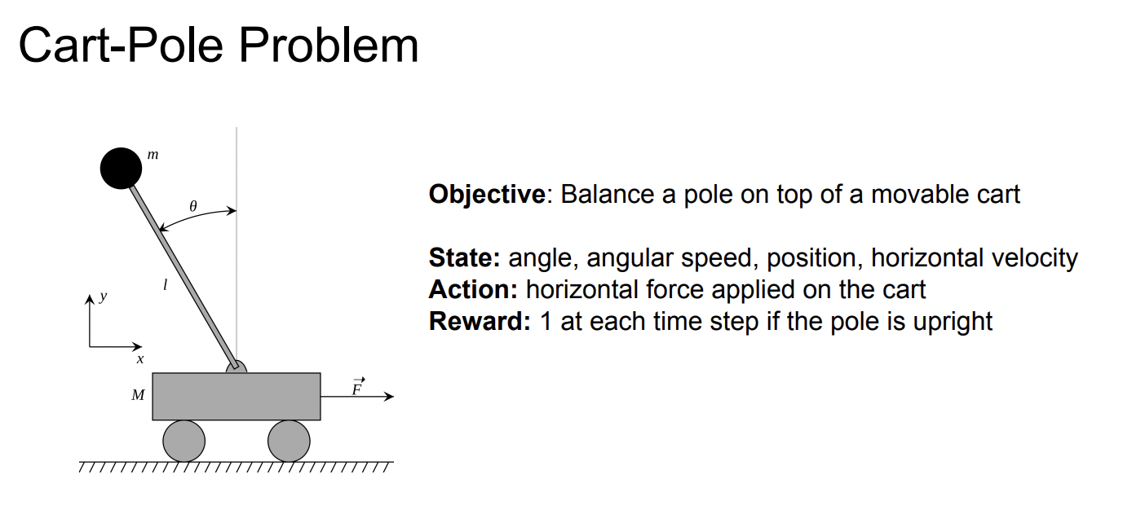
More RL examples

Slide 11
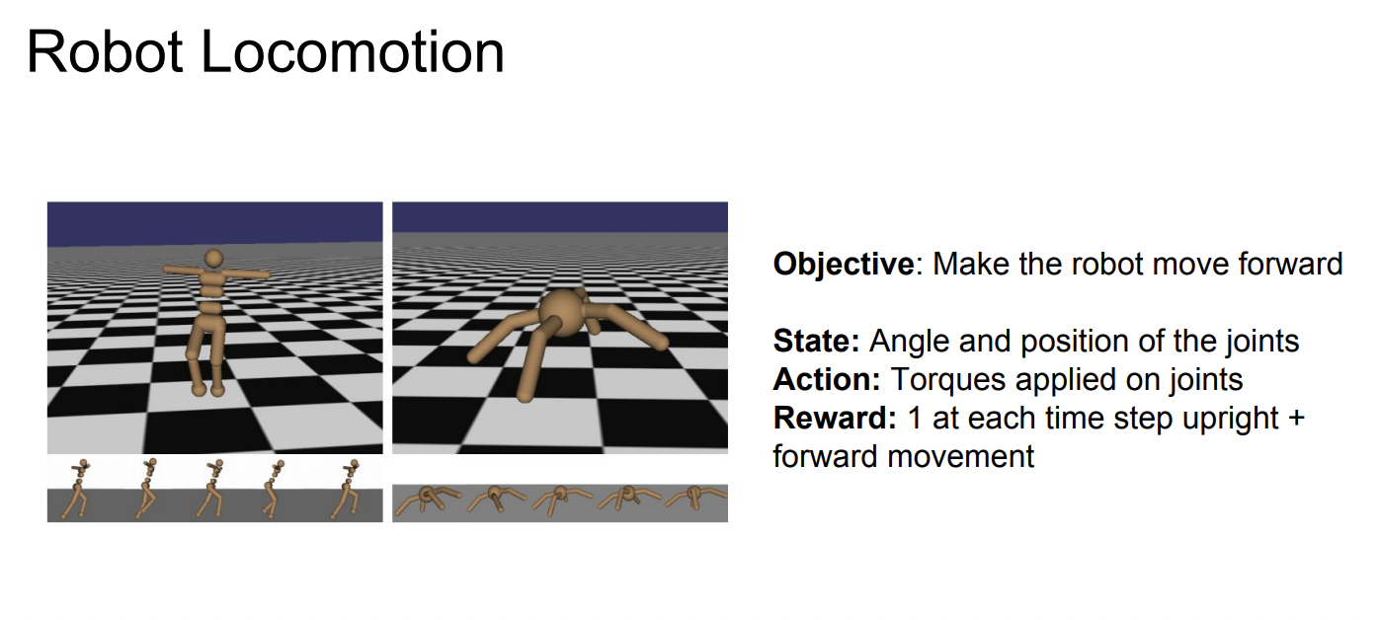
More RL examples

Slide 12
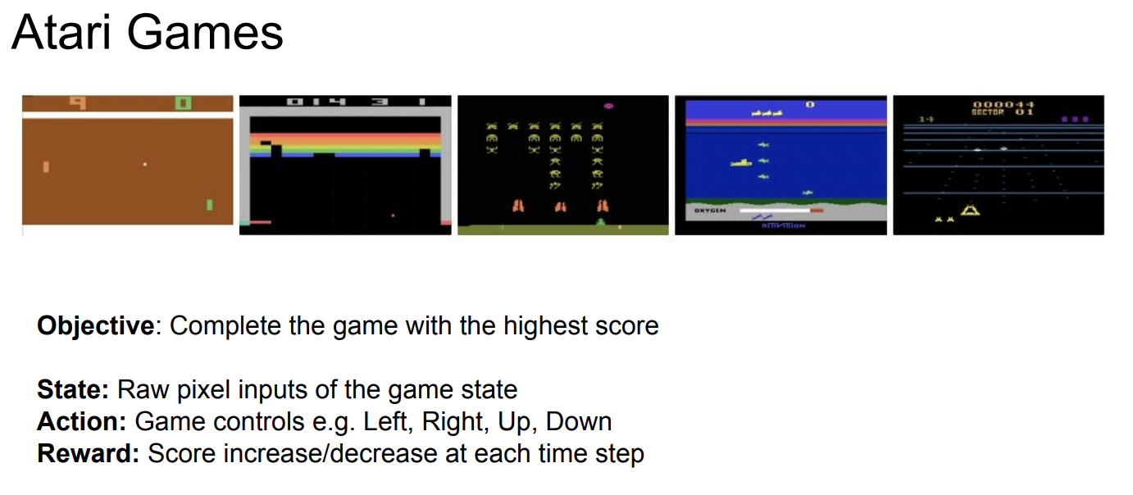
More RL examples

Slide 13
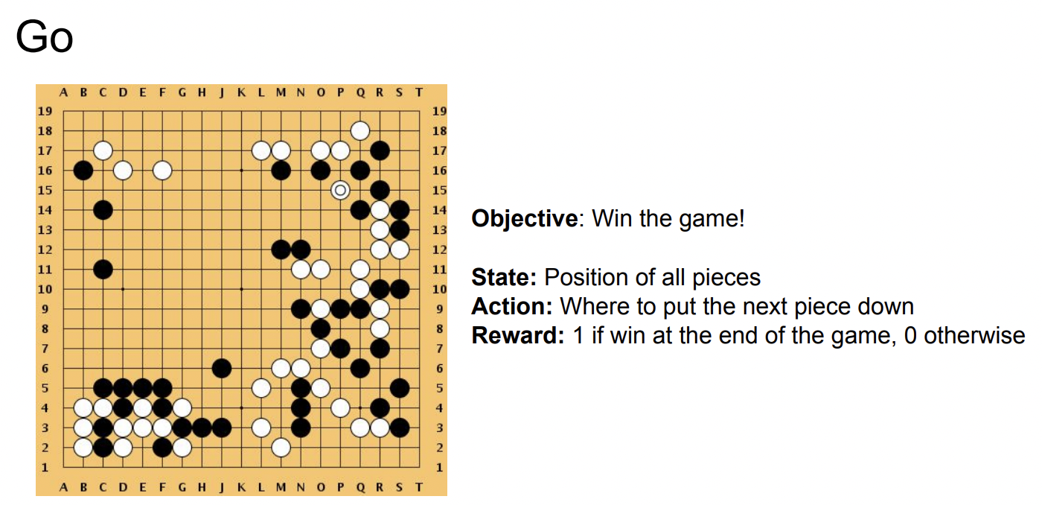
More RL examples

Slide 14
Few more RL terminologies
Policy (∏):
A policy is a mapping from the perceived states of the environment to actions to be taken when in those states
A reinforcement learning agent uses a policy to select actions given the current environment state
Reward :
The reward defines the goal
On each time step, the environment sends a reward to the reinforcement learning agent
The agent’s objective is to maximize the total reward that it receives over the long run
The reward signal is used to alter the policy.
Value Function V(s):
The reward signal indicates what is good in the short run while the value function indicates what is good in the long run.
The value of a state is the total amount of reward an agent can expect to accumulate over the future, starting in that state

Slide 15
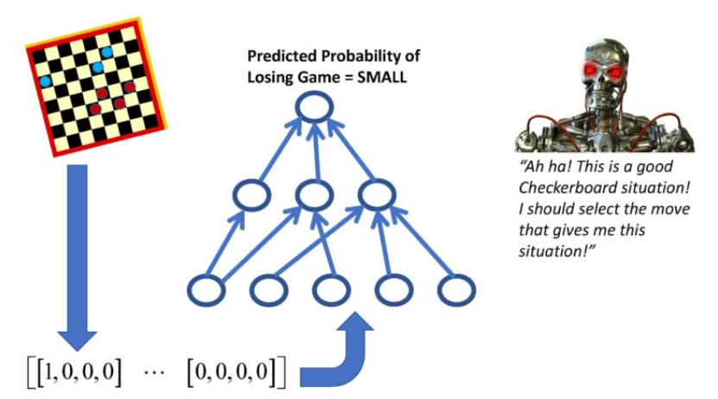
Value Function V(s)
The value of a state is the total amount of reward an agent can expect to accumulate over the future, starting in that state.
The value is computed using the states that are likely to follow the current state and the rewards available in those states.
Value function is used to evaluate decisions and make action choices.
Actions that bring about states of highest value is preferred instead of highest reward
Rewards are given directly by the environment
Values must continually be re-estimated from the sequence of observations that an agent makes over its lifetime

Slide 16
Positive and Negative Reinforcement
Positive Reinforcement increases the strength and the frequency of a specific behavior and impacts positively on the action taken by the agent.
It helps you to maximize performance and sustain change for a more extended period.
However, too much Reinforcement may lead to over-optimization of state, which can affect the results.
Negative Reinforcement is defined as strengthening of behavior that occurs because of a negative condition which should have stopped or avoided.
It helps to define the minimum stand of performance.
However, the drawback of this method is that it provides enough to meet up the minimum behavior.

Slide 17
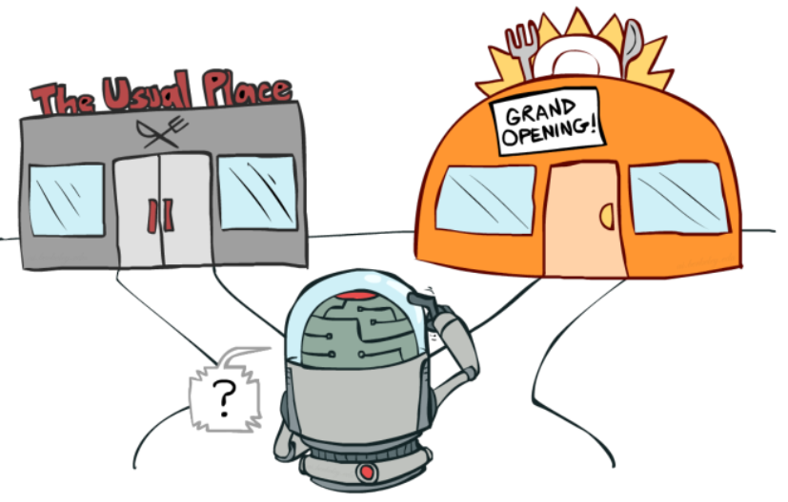
Exploration Vs Exploitation
In order to build an optimal policy, the agent faces the dilemma of exploring new states while maximizing its reward at the same time. This is Exploration vs Exploitation trade-off.
Exploitation: Go with the best strategy found so far. Agent needs to exploit the current knowledge to get better rewards.
Exploration: Take a new action with unknown consequences. This is to explore to get more information about the environment (How do we know if there is not a pot of gold around the corner). To explore, we need to take actions that may not seem the best according to the current model.
Managing trade off between exploration and exploitation is critical issue in RL.
Basic approach:
Explore more when knowledge is weak.
Exploit more as we gain more knowledge.

Slide 18
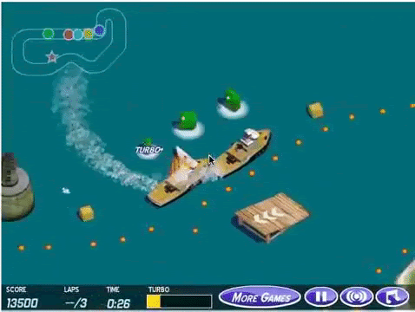
Sparse Rewards in RL
Sparse rewards are those given for only a small handful of states / events. Often rewards are given at the end – this is Sparse reward setting. However, a problem arises when an environment rarely produces an useful reward signal, which severely challenges the way ordinary RL agent attempts to learn.
However, giving dense rewards to the agent at different states can also be difficult. Because it can often be hard to define and also cannot be generalized across different tasks. Eg: Chess has 10^80 board cofigurations and configuring dense rewards is very difficult.
The most intuitive solution to sparse reward problems is reward shaping. Using reward shaping, we enhance the primary reward of the environment with some additional reward features to appropriately reward or punish interactions of the agent, filling the gap of the original sparse reward space.
Reward shaping is a critical issue in RL, as it can change the optimal policy if they are not potential-based. Consider an agent controlling a boat in the Coast Runners game, where the intended goal was to finish the boat race as quickly as possible. The agent was given a shaping reward for hitting green blocks along the race track, which changed the optimal policy to going in circles and hitting the same green blocks over and over again

Slide 19
Credit Assignment Problem
Assigning credit for each intermediate action based on a delayed reward is a challenging problem denoted the temporal Credit Assignment Problem (CAP).
The credit assignment problem concerns determining how the success of a system’s overall performance is due to the various contributions of the system’s components (Minsky, 1963).
Given a sequence of states and actions, and the final sum of time-discounted future rewards, how do we infer which actions were effective at producing lots of reward and which actions were not effective?
How do we assign credit for the observed rewards given a sequence of actions over time?
Every reinforcement learning algorithm must address this problem
Minsky, M. L. (1963). Steps toward artificial intelligence. In E. A. Feigenbaum & J. Feldman (Eds.), Computers And Thought (pp. 406-450). New York, NY: McGraw-Hill.

Slide 20
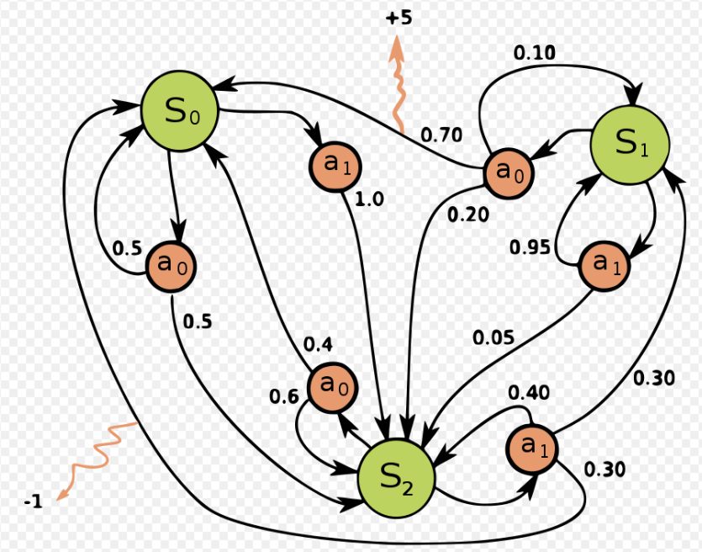
Model-based Vs Model-free RL learning
In the context of reinforcement learning (RL), the model allows inferences to be made about the environment. For example, the model might predict the resultant next state and next reward, given a state and action.
Often an RL environment can be described with a Markov decision process (MDP). It consists of a set of states, a set of rewards, and a set of actions, and the goal the agent has to maximize and the state transition probabilities.
A lot of Reinforcement Learning problems with discrete actions are modeled as Markov decision processes.
These models are used for planning; to decide on a course of action by considering possible future situations.
Methods for solving reinforcement learning problems that use models and planning are called model-based methods, as opposed to simpler model-free methods that are explicitly trial-and-error learners

Slide 21
Model-based Vs Model-free RL learning
Reinforcement learning (RL) has two distinct computational strategies- Model-based and model-free learning.
Model-based, as it sounds, has an agent trying to understand its environment and creating a model for it based on its interactions with this environment. In such a system, preferences take priority over the consequences of the actions i.e. the greedy agent will always try to perform an action that will get the maximum reward irrespective of what that action may cause.
On the other hand, model-free algorithms seek to learn the consequences of their actions through experience via algorithms such as Policy Gradient, Q-Learning, etc. In other words, such an algorithm will carry out an action multiple times and will adjust the policy (the strategy behind its actions) for optimal rewards, based on the outcomes.
This results in different applications for these two classes, for e.g. a model-based approach may be the perfect fit for playing chess or for a robotic arm in the assembly line of a product, where the environment is static and getting the task done most efficiently is our main concern. However, in the case of real-world applications such as self-driving cars, a model-based approach might prompt the car to run over a pedestrian to reach its destination in less time (maximum reward), but a model-free approach would make the car wait till the road is clear (optimal way out).

Slide 22
RL learning Algorithms
Value-iteration and Policy-iteration algorithms
These are two fundamental methods for solving Markov Decision Processes (MDPs).
Both value-iteration and policy-iteration algorithms can be used for offline planning where the agent is assumed to have prior knowledge about the effects of its actions on the environment (they assume the MDP model is known) i.e. in model-based learning.
Both algorithms assume that the agent knows the MDP model of the world (i.e. the agent knows the state-transition and reward probability functions). Therefore, they can be used by the agent to (offline) plan its actions given knowledge about the environment before interacting with it.
The value function (V(s)) represent how good is a state for an agent to be in. It is equal to the expected total reward for an agent starting from state s. Value iteration computes the optimal state value function by iteratively improving its prior estimate.
While value-iteration algorithm keeps improving the value function at each iteration until the value-function converges. The policy-iteration algorithm computes the policy at each step and then compute the value function according to this new policy, until convergence. Policy iteration is also guaranteed to converge to the optimal policy and it often takes less iterations to converge than the value-iteration algorithm.

Slide 23
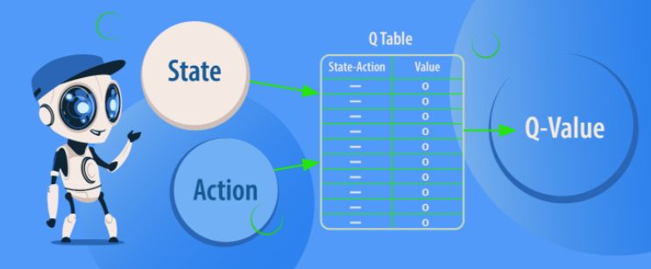
RL learning Algorithms
Q-learning which is a model-free learning algorithm can be used in situation where the agent initially knows only the possible states and actions but doesn't know the state-transition probabilities. In Q-learning, the agent improves its behavior through learning from the history of interactions with the environment.
Q-Learning does not assume that agent knows anything about the state-transition and reward models. However, the agent will discover what are the good and bad actions by trial and error.
Q-learning agent may also utilize policies of other agents. Hence it is also called off-policy because the updated policy is different from the behavior policy. Off-policy learning can be very cost-effective when it comes to deployment in real-world, reinforcement learning scenarios. The characteristic of the agent to explore and find new ways and cater for the future rewards task makes it a suitable candidate for flexible operations.
Eg: Q-learning can be used for building a self-playing PacMan agent.

Slide 24
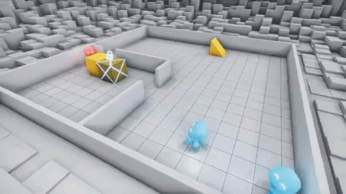
Multi-Agent Reinforcement Learning (MARL)
A multi-agent system is a group of autonomous, interacting agents sharing a common environment, which they perceive with sensors and upon which they act with actuators .
Multi-agent systems are finding applications in a variety of domains including robotic teams, distributed control, resource management, collaborative decision support systems, data mining.
In multi-agent systems, there are two forms of learning: centralized learning, that is, learning done by a single agent independent of the other agents; and distributed learning, that is, learning that becomes possible only because several agents are present
MARL can be further broken down into :
· Cooperative: All agents working towards a common goal
· Competitive: Agents competing with one another.
· Some mix of the two: Think a 5v5 basketball game, where individuals on the same team are coordinating with one another, but the two teams are competing against one another.
Agents learning to play hide and seek

Slide 25
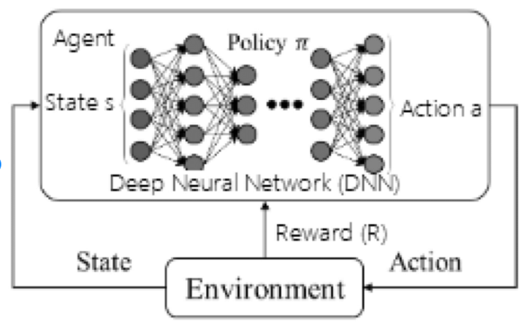
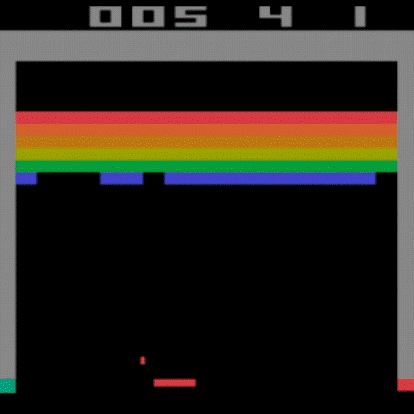
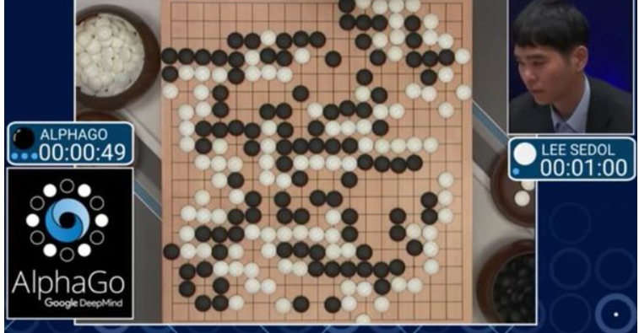
Deep Reinforcement Learning
Deep reinforcement learning combines artificial neural networks with a framework of reinforcement learning that helps the agents learn how to reach their goals. For example, using a neural network to learn the optimal policy.
Advancement in Deep RL
Excel humans in a series of classic Atari games. The RL agent is trying to maximize the score by breaking all the blocks. After a few hours of training, it has an epiphany- it realizes that if it actually tunnels through the game, it can use the physics of the game to win it !!
AlphaGo designed by Google’s DeepMind emphatically outplayed and outclassed Mr. Sidol and won the series 4-1., The algorithm (based on CNN) was guided by several human experts during the training phase. The next generation AlphaGo Zero (based on residual architecture)was self-trained with hours and hours of training and beat its predecessor.

Slide 26
Lab Work

